Slide 1
Tutorial 2
Formatting Workbook Text and Data

Slide 2
Objectives
Change fonts, font style, and font color
Add fill colors and a background image
Create formulas to calculate sales data
Apply Currency and Accounting formats and the Percent style
Format dates and times
Align, indent, and rotate cell contents
Merge a group of cells
2

Slide 3
Objectives
Use the AVERAGE function
Apply cell styles
Copy and paste formats with the Format Painter
Find and replace text and formatting
Change workbook themes

Slide 4
Objectives
Highlight cells with conditional formats
Format a worksheet for printing
Set the print area, insert page breaks, add print titles, create headers and footers, and set margins

Slide 5
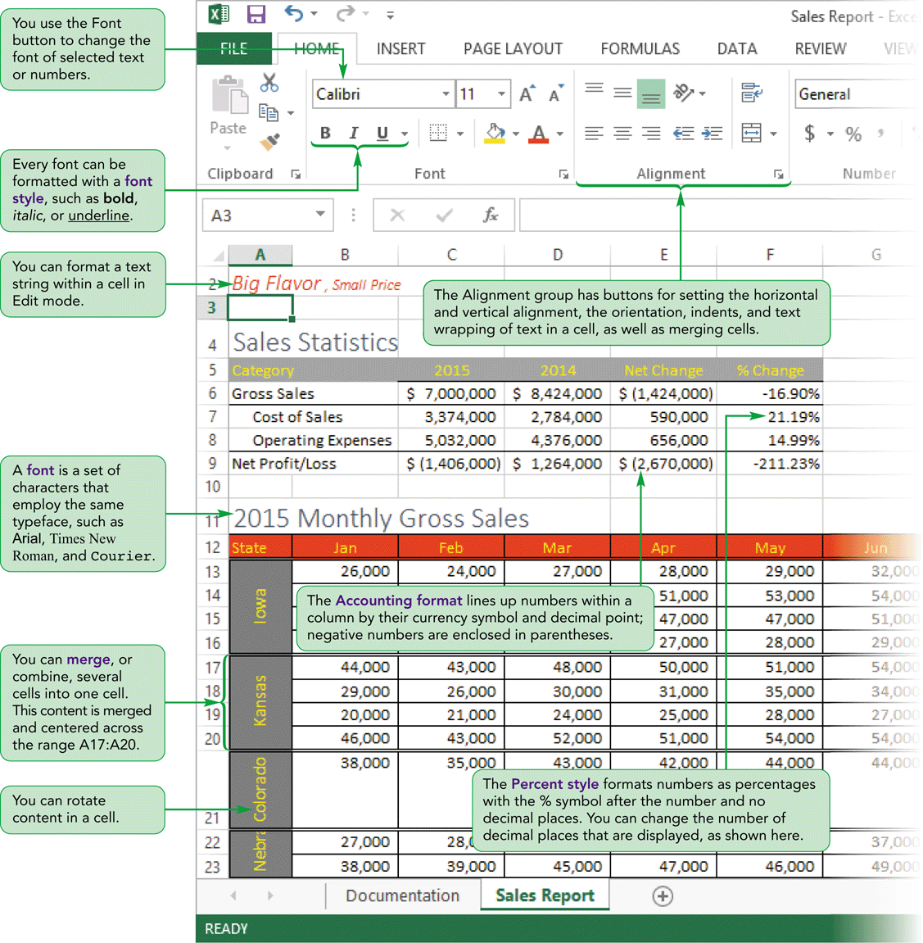
Visual Overview
Worksheet with Formatting

Slide 6
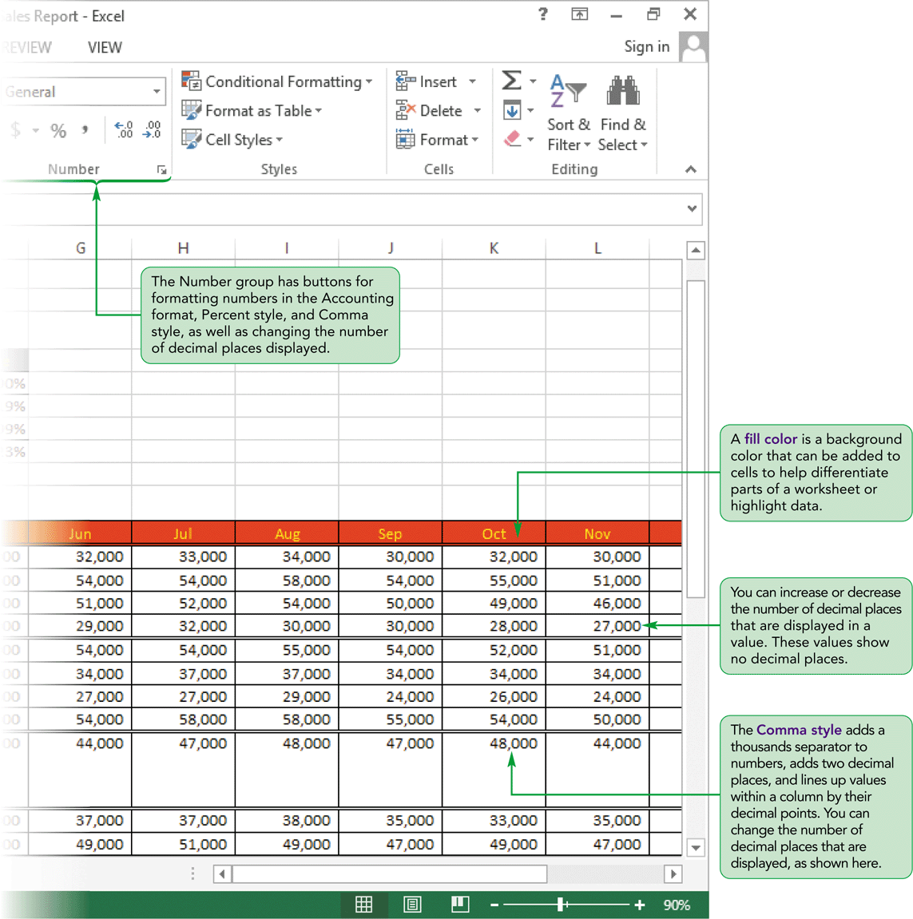
Visual Overview
Worksheet with Formatting

Slide 7
Formatting Cell Text
You can add formatting to a workbook by choosing its fonts, styles, colors, and decorative features through the use of themes
A theme is a collection of formatting for text, colors, and graphical effects that are applied throughout a workbook to create a specific look and feel

Slide 8
Formatting Cell Text
As you format a workbook, galleries and Live Preview show how a workbook would be affected by a formatting selection
  A Gallery is a menu that shows a visual representation of the options available for the selected button
  Live Preview shows the effects of formatting options before you apply them; by pointing to different options, you can quickly see different results before selecting the format you want

Slide 9
Applying Fonts and Font Styles
Theme font
  Associated with a particular theme
  Used for headings and body text
  Change automatically when you change the theme applied to the workbook
Text formatted with a non-theme font retains its appearance no matter what theme is used with the workbook

Slide 10
Applying Fonts and Font Styles
Character styles
  Serif fonts have extra strokes at the end of each character
  Sans serif fonts do not have extra strokes
Every font can be further formatted with:
  A font style such as italic, bold, or bold italic
  Underline
  Special effects such as strikethrough and color
Can increase or decrease the font size

Slide 11
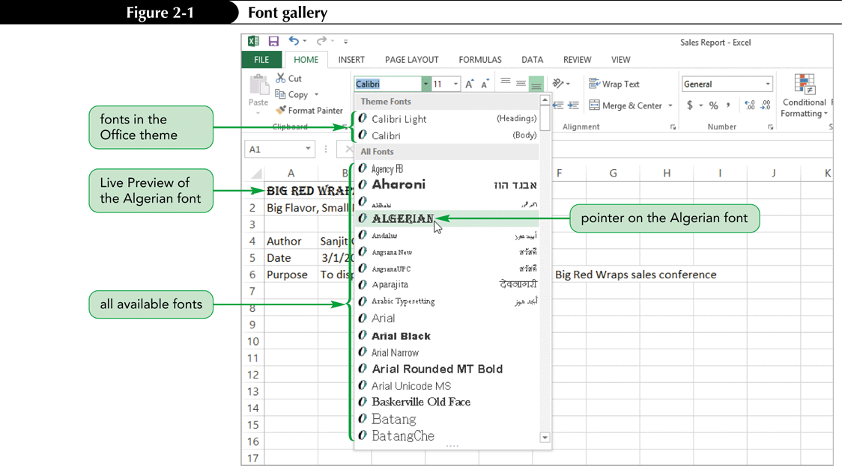
Applying Fonts and Font Styles

Slide 12
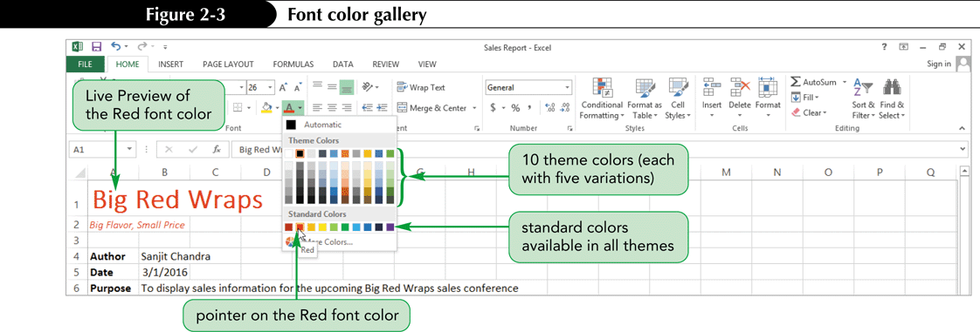
Applying a Font Color
Theme colors are the 12 colors that belong to the workbook’s theme: 4 for text and backgrounds, 6 for accents and highlights, and 2 for hyperlinks
Standard colors are always available
Can also create custom colors

Slide 13
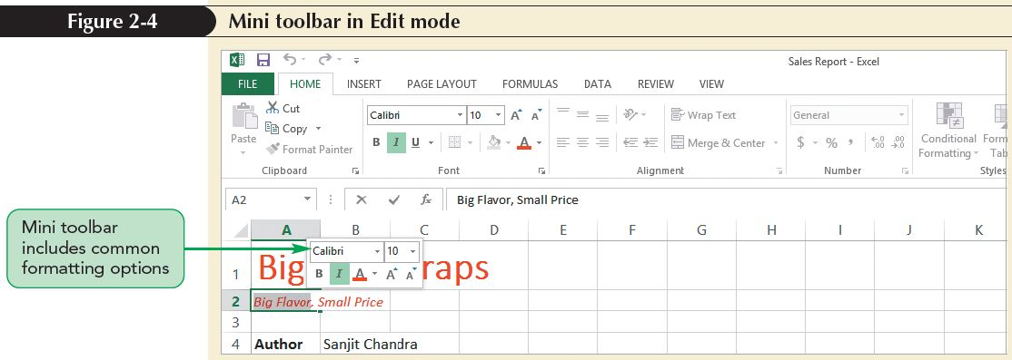
Formatting Text Selections
The Mini toolbar contains buttons for common formatting options used for the selection

Slide 14
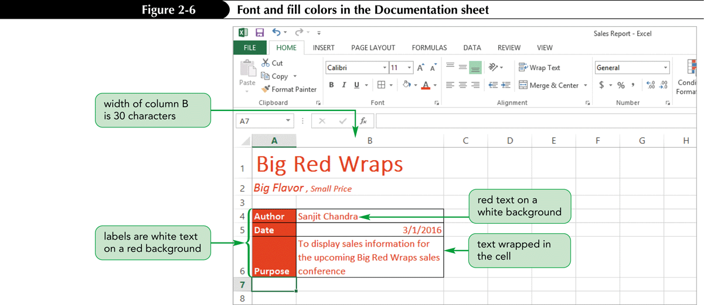
Working with Fill Colors and Backgrounds
Fill colors can be helpful for distinguishing different parts of a worksheet or adding visual interest

Slide 15
Changing a Fill Color
Select the range you wish to apply a fill color to
On the HOME tab, in the Font group, click the Fill Color button arrow, and then click the specific color you wish to use in the Standard Colors section

Slide 16
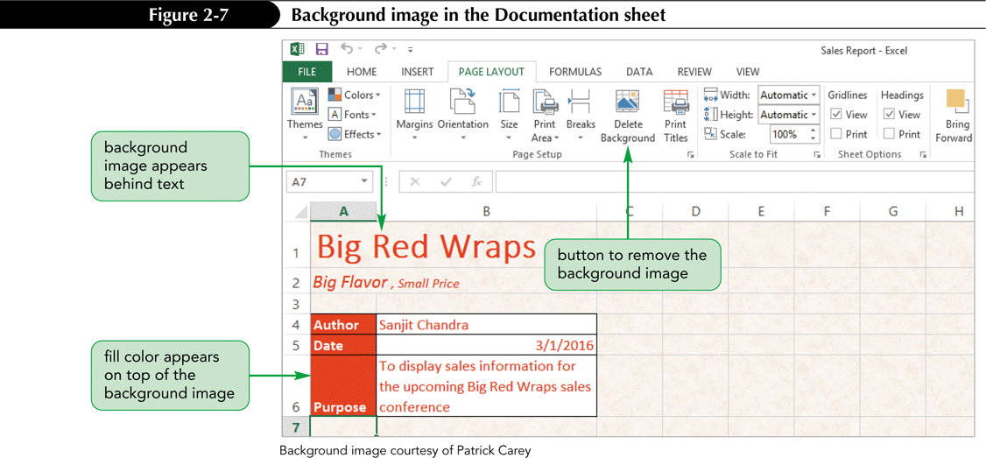
Working with Fill Colors and Backgrounds
Background images can provide a textured appearance on screen; they do not print

Slide 17
Adding a Background Image
On the ribbon, click the PAGE LAYOUT tab to display the page layout options
In the Page Setup group, click the Background button
Click the Browse button; the Sheet Background dialog box opens allowing you to navigate to the file location
Select the file, and then click Insert; the image is added to the background

Slide 18
Using Functions and Formulas to Calculate Sales Data
In Excel, you can collet sales data such as:
  Gross Sales
  Cost of Sales
  Operating Expenses
  Net profit/Loss
  Units Sold
  Customers Served
Sales data can be used to calculate sales statistics for an entire company or specific stores and products

Slide 19
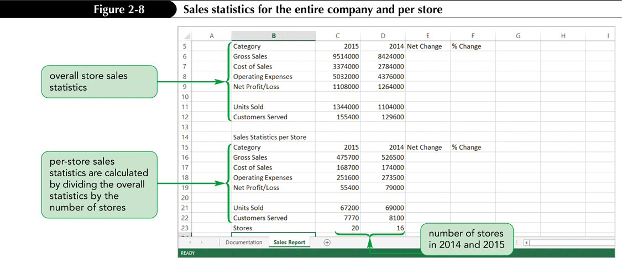
Using Functions and Formulas to Calculate Sales Data

Slide 20
Formatting Numbers
Goal: Make workbook easier to interpret
Accomplished by:
  Adding a comma as a thousands separator
  Setting the number of decimal places
  Using percentage and currency symbols

Slide 21
Applying Number Formats
General format displays numbers exactly as they are typed
Some numbers may require formatting to make interpretation easier; you might need to:
  Change the number of digits displayed to the right of the decimal point
  Add commas to separate thousands in large numbers
  Apply currency symbols to numbers to identify the monetary unit being used
  Display percentages using the % symbol

Slide 22
Applying Number Formats
Excel supports two monetary formats
  Currency format
    Places a currency symbol left of the first digit
    Displays negative numbers with a negative sign
  Accounting format
    Fixes a currency symbol at the left edge of the column
    Displays negative numbers within parentheses
    Displays zero values with a dash
    Slightly indents values from the right edge

Slide 23
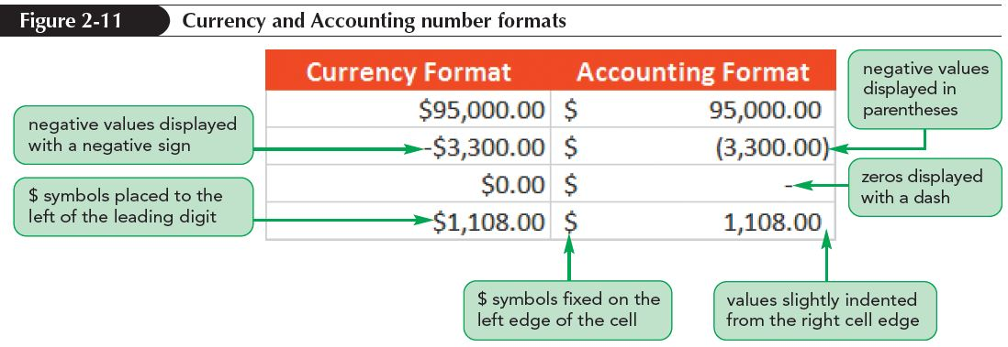
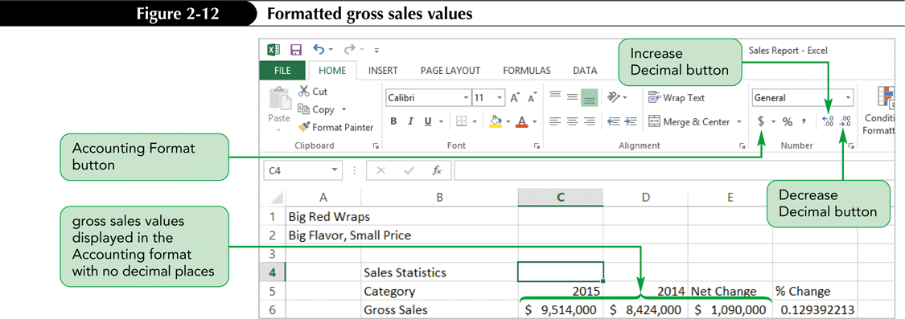
Applying Number Formats

Slide 24
Formatting Dates and Times
Dates and times are stored as numbers, not as text, so you can apply different formats without affecting values
Short Date format: mm/dd/yyy
Long Date format displays the day of the week and the full month name in addition to the day of the month and the year
Other built-in formats include formats for time in 12- or 24-hour formats

Slide 25
Formatting Dates and Times
To format the date and time
  Select the cell in which the date and time should appear
  On the ribbon, select the HOME tab
  In the Number group, click the Number Format button arrow to display a list of number formats
  Select the preferred format

Slide 26
Formatting Worksheet Cells
Format appearance of individual cells by:
  Modifying alignment of text within the cell
  Indenting cell text
  Adding borders of different styles and colors

Slide 27
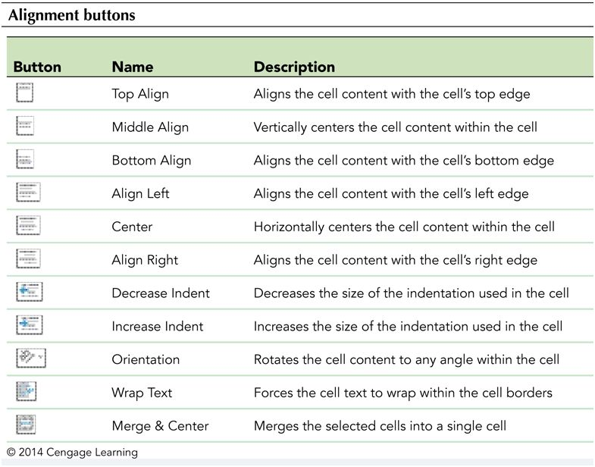
Aligning Cell Content
Default:
  Text aligned with left bottom borders
  Numbers aligned with right bottom border
Buttons to set alignment options are in Alignment group on HOME tab

Slide 28
Formatting Worksheet Cells
Indenting is useful for creating subsections
In common accounting practices:
  A single black border appears above a subtotal
  A single bottom border is added below a calculated number
  A double black bottom border appears below the total

Slide 29
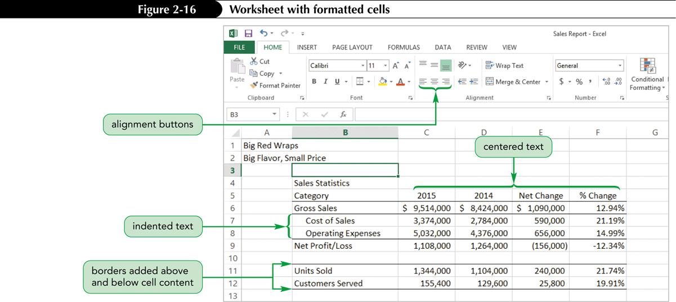
Formatting Worksheet Cells

Slide 30
Merging Cells
Retains only content (and cell reference) from upper-left cell in the range
Merge options:
  Merge & Center—merges the range into one cell and horizontally centers the content
  Merge Across—merges each row in the selected range across the columns in the range
  Merge Cells—merges the range into a single cell, but does not horizontally center the cell content
  Unmerge Cells—reverses a merge, returning the merged cell to a range of individual cells

Slide 31
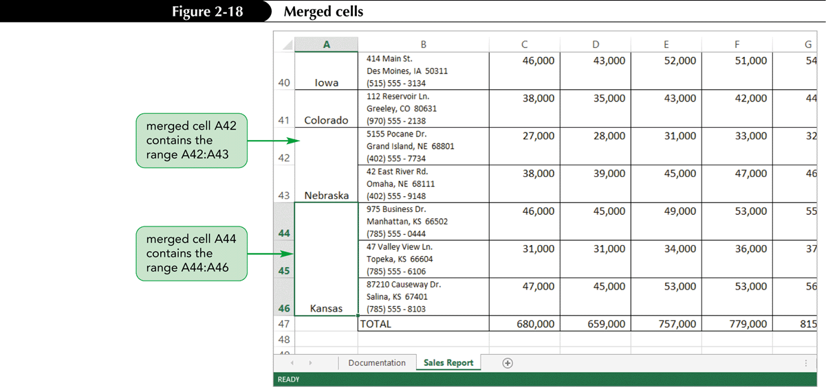
Merging Cells

Slide 32
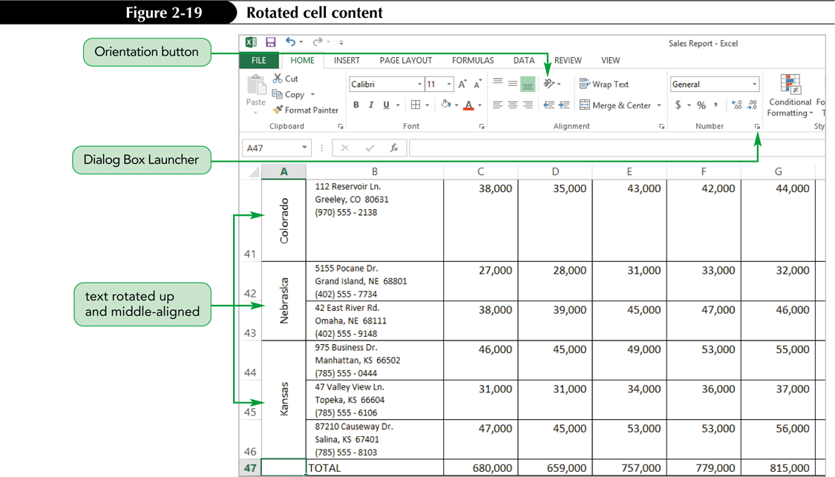
Rotating Cell Contents
Can rotate cell text to any angle to save space or provide visual interest

Slide 33
Exploring the
Format Cells Dialog Box
Buttons on the HOME tab provide quick access to commonly used formatting
The Format Cells dialog box provides more options for formatting selected cells; six tabs, each focusing on different options:
  Number
  Alignment
  Font
  Border
  Fill
  Protection

Slide 34
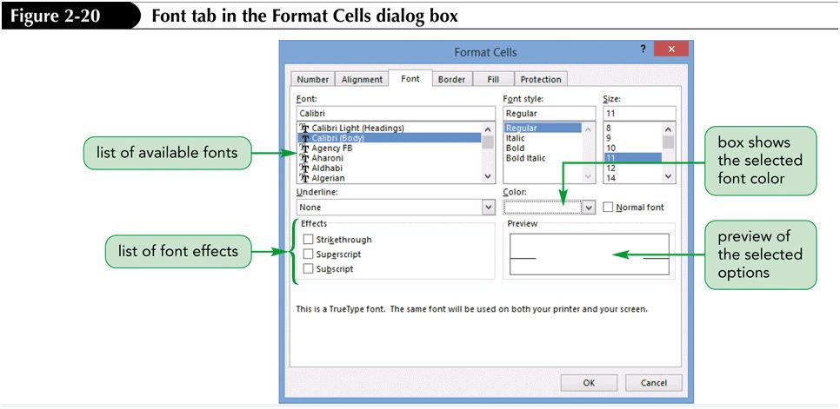
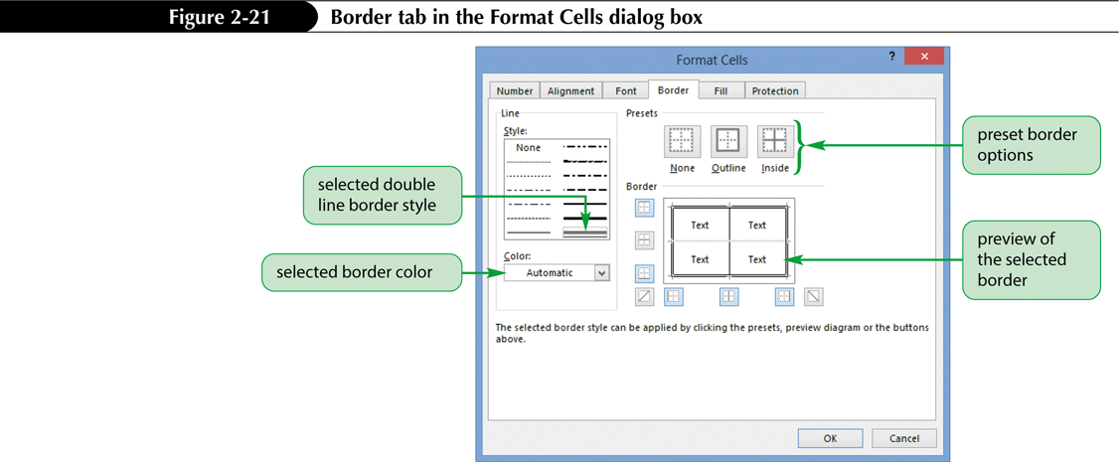
Format Cells Dialog Box Options

Slide 35
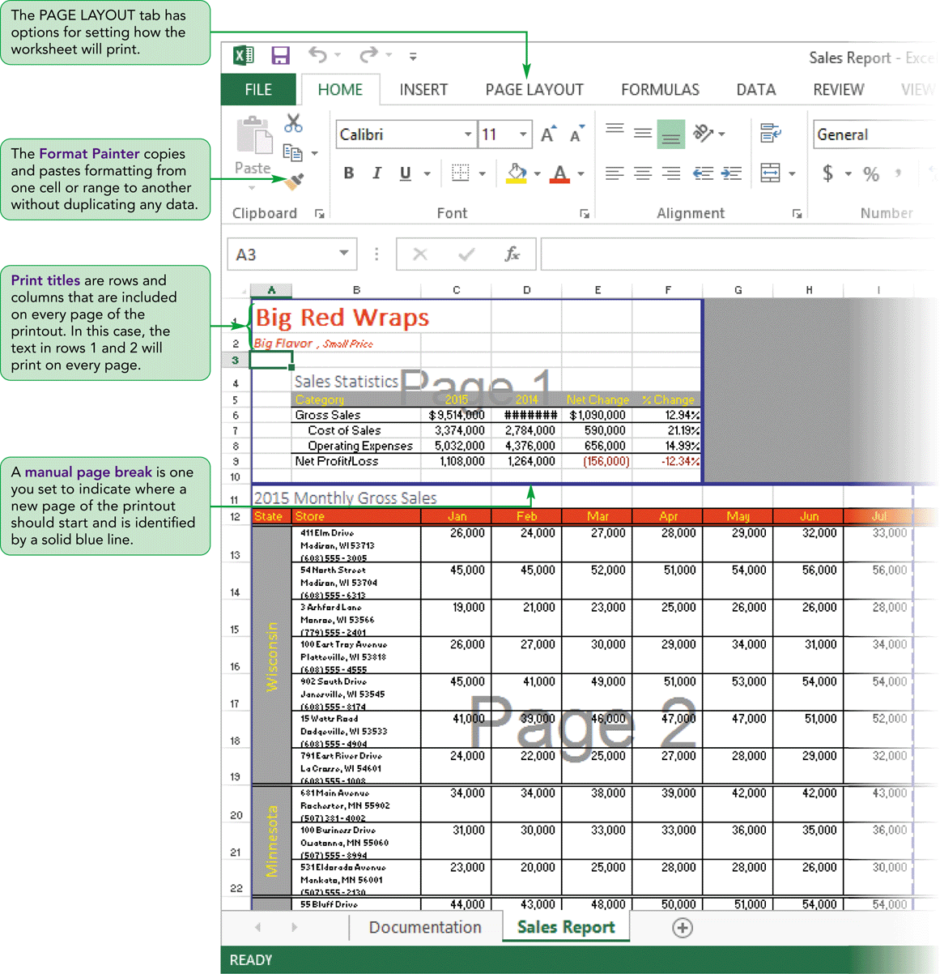
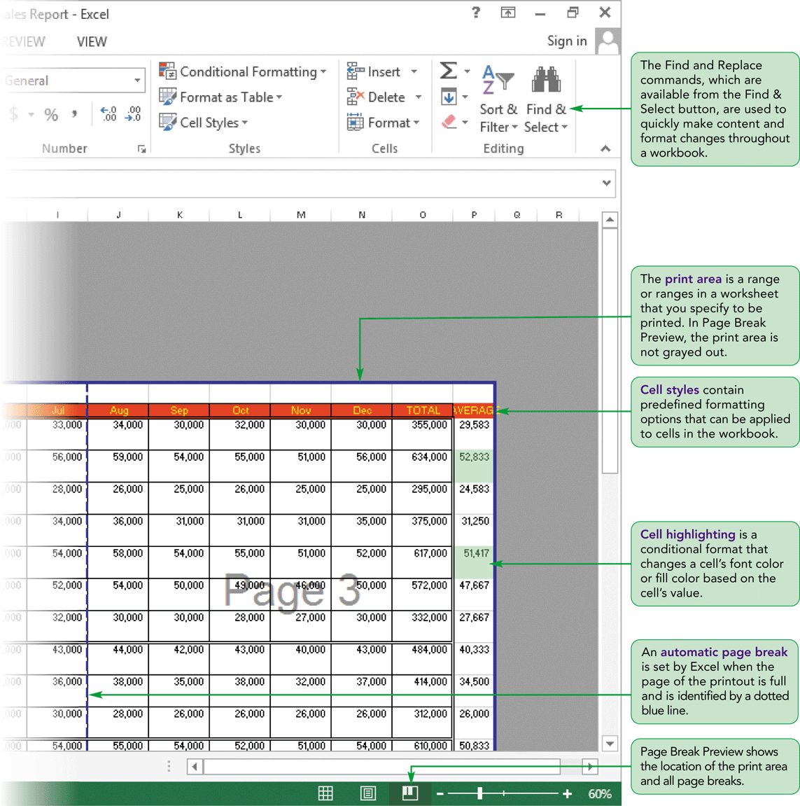
Visual Overview
Worksheet Formatted for Printing

Slide 36
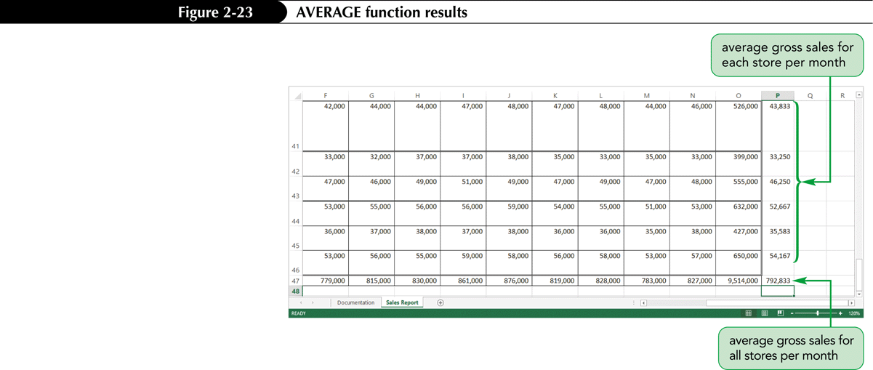
Using the Average Function
The AVERAGE function calculates the average value from a collection of numbers
The syntax of the Average function is:
  AVERAGE (number1, number2, number3, …)

Slide 37
Applying Cell Styles
Use styles to ensure that cells displaying same type of data use the same format
A style is a collection of formatting options that include a specified font, font size, font styles, font color, fill color, and borders
If a style is later revised, the appearance of any cell formatted with that style is updated automatically

Slide 38
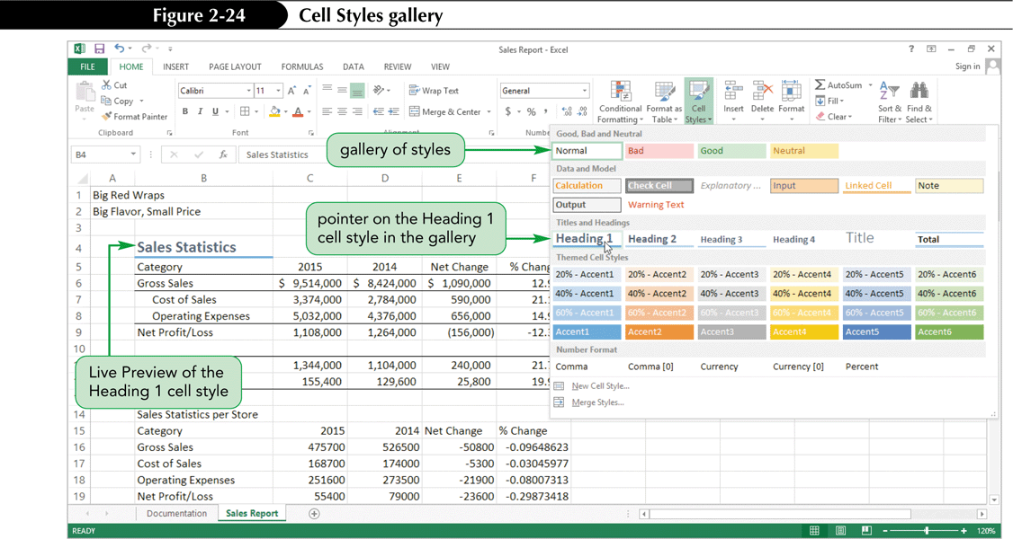
Applying Cell Styles

Slide 39
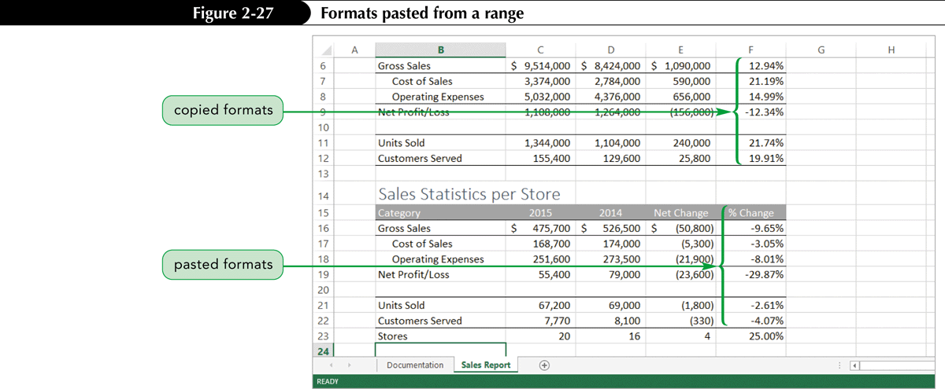
Copying and Pasting Formats
Copying formats with the Format Painter
  Fast and efficient way of maintaining a consistent look and feel throughout a workbook
  Copies formatting without copying data

Slide 40
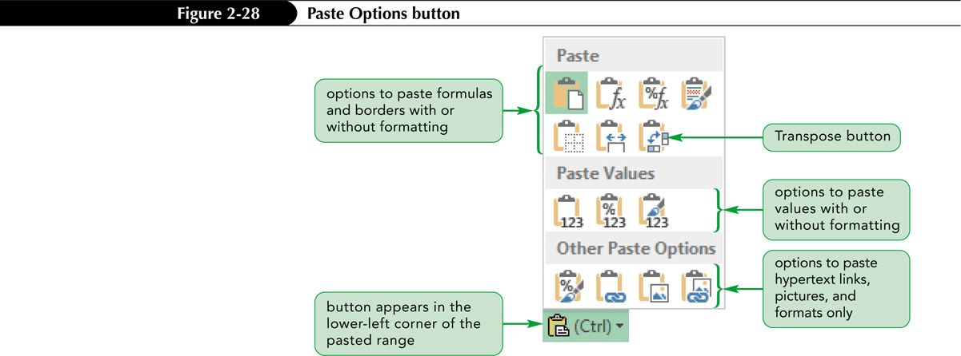
Copying and Pasting Formats
Use Paste Options button to paste formatting from a copied range along with its contents

Slide 41
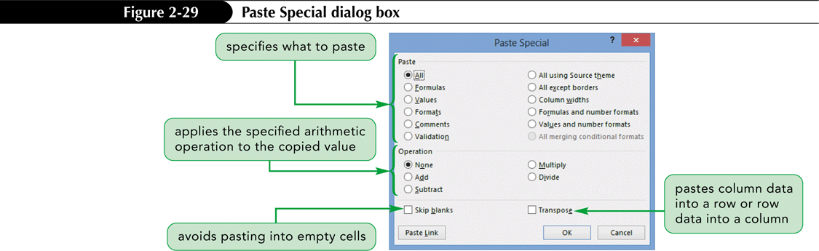
Copying and Pasting Formats
Use Paste Special to control exactly how to paste the copied range

Slide 42
Finding and Replacing Text and Formats
The Find and Replace commands let you make content and design changes to a Worksheet or the entire workbook quickly
The Find command searches through the current worksheet or workbook for the content or formatting you want to locate
The Replace command then substitutes it with the new content or formatting you specify

Slide 43
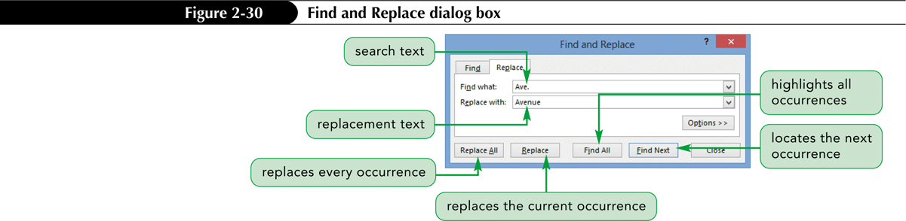
Finding and Replacing Text and Formats
You can choose to:
  Find each occurrence of the search text one at a time and decide whether to replace it
  Highlight all occurrences of the search text in the worksheet
  Replace all occurrences at once without reviewing

Slide 44
Working with Themes
Appearance of fonts, colors, and cell styles depends on workbook’s current theme
If theme is changed, formatting of fonts, colors, and cell styles changes throughout entire workbook
Only elements directly tied to a theme change when you select a different theme

Slide 45
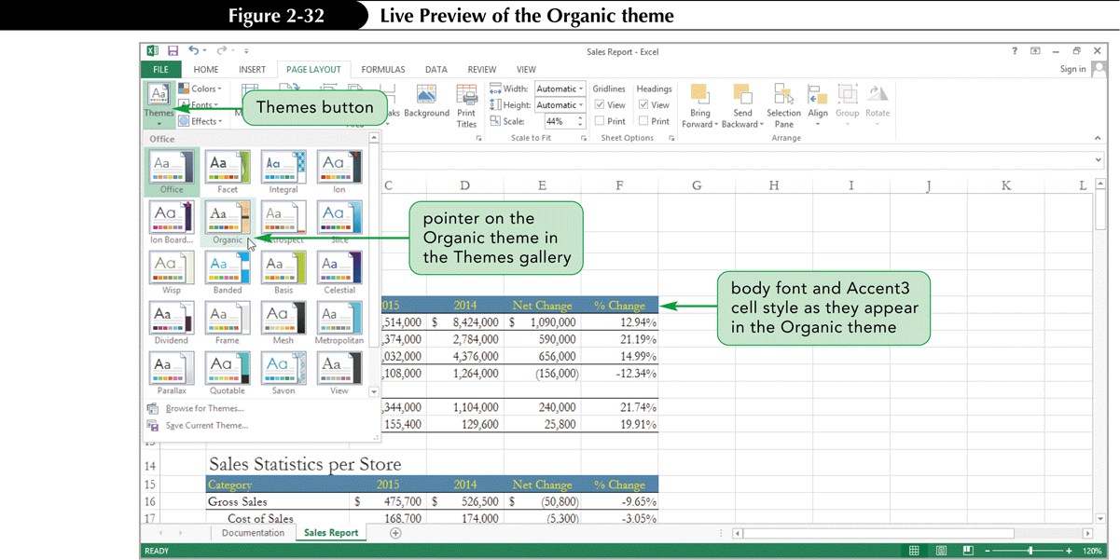
Working with Themes

Slide 46
Highlighting Cells with
Conditional Formats
A conditional format applies formatting to a cell when its value meets a specified condition
Dynamic: the formatting can change when the cell’s value changes
Excel has four conditional formats:
  Data bars
  Highlighting
  Color scales
  Icon sets

Slide 47
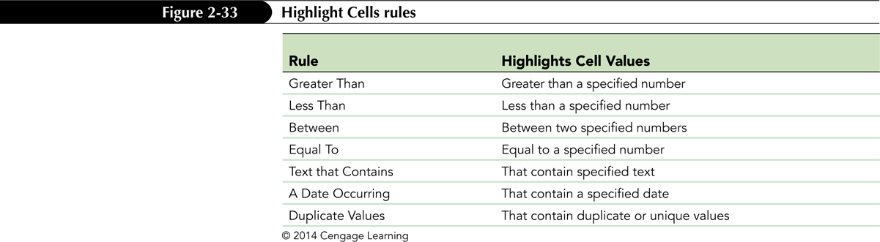
Highlighting Cells with
Conditional Formats
Each conditional format has a set of rules that define how formatting should be applied and under what conditions the format will change

Slide 48
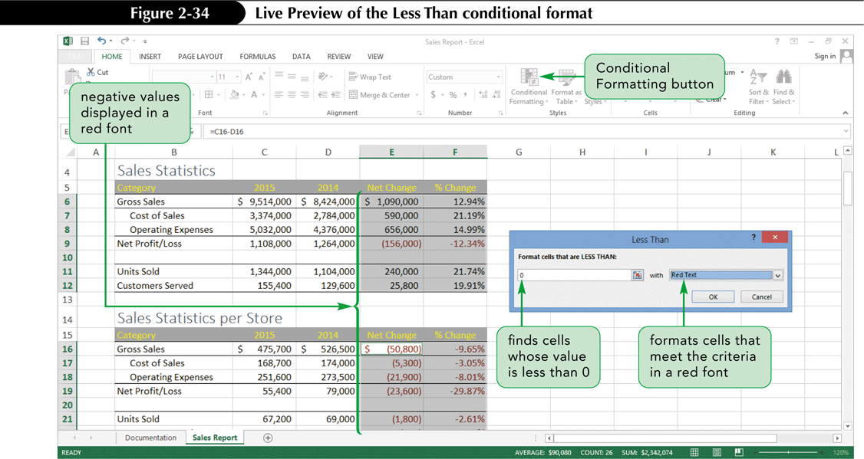
Highlighting Cells with
Conditional Formats

Slide 49
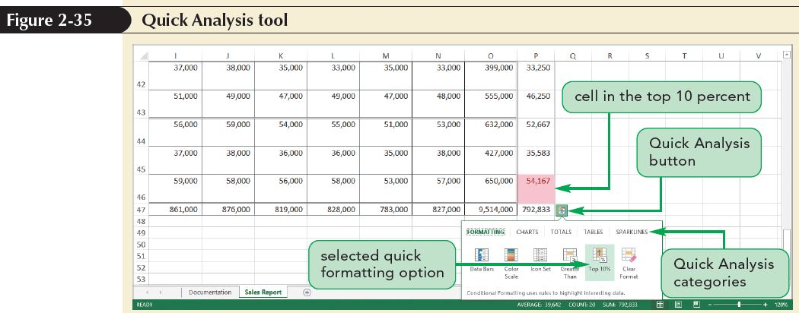
Highlighting Cells with
Conditional Formats
The Quick Analysis tool provides access to the most common tools for data analysis and formatting

Slide 50
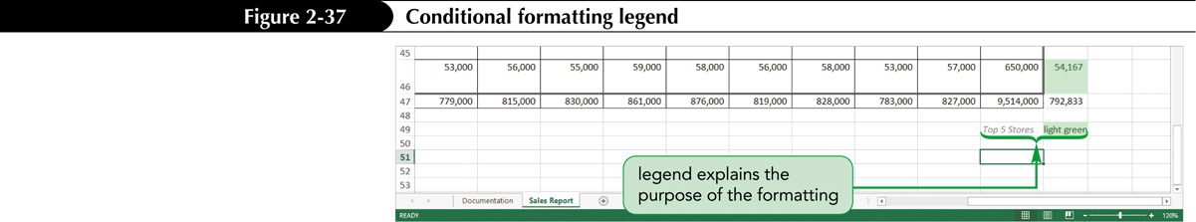
Highlighting Cells with
Conditional Formats
You can remove a conditional format at any time without affecting the underlying data
Always include a legend—a key that identifies each color and its meaning

Slide 51
Formatting a Worksheet for Printing
Print settings can be applied to an entire workbook or to individual sheets
Page Break Preview shows only those parts of the active sheet that will print and how the content will be split across pages

Slide 52
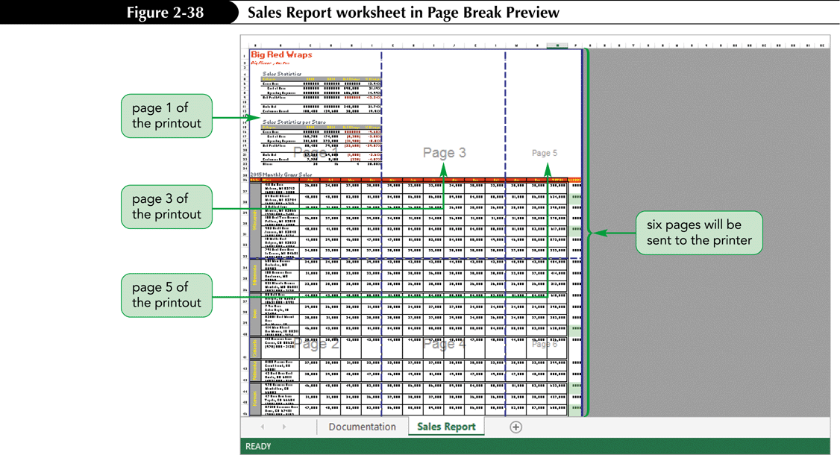
Formatting a Worksheet for Printing

Slide 53
Formatting the Worksheet for Printing
By default, all cells in a worksheet containing text, formulas, or values are printed
You can set a print area
  Region of the worksheet sent to the printer
  Can be set in any view
  Page Break Preview shades the areas that are included in the print area
  Can cover adjacent or nonadjacent range in current worksheet

Slide 54
Formatting the Worksheet for Printing
Inserting page breaks
  When the contents of a worksheet will not fit onto a single printed page, Excel prints as much of the content as fits on a single page without resizing, and then inserts automatic page breaks to continue printing the remaining worksheet content on successive pages
  To split the printout into logical segments, you can insert manual page breaks

Slide 55
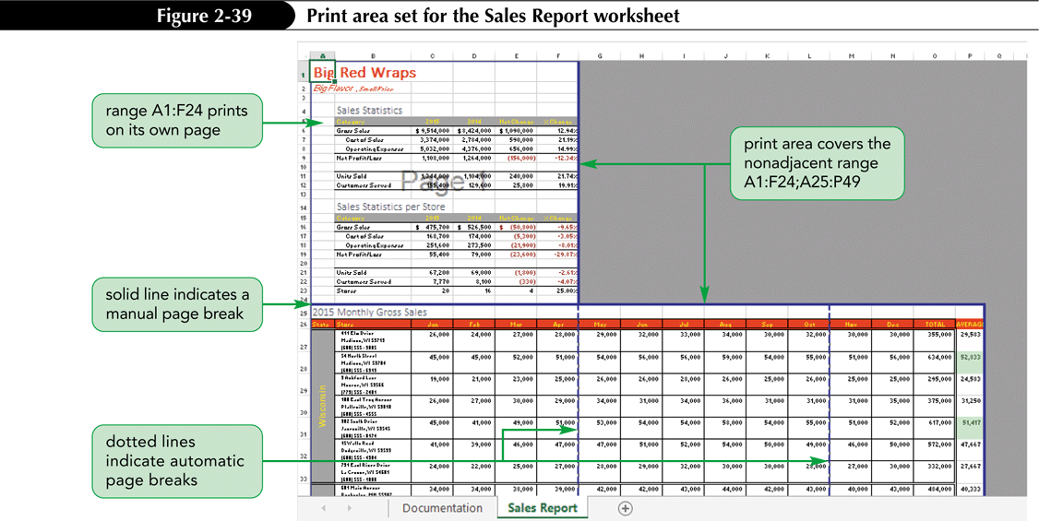
Formatting the Worksheet for Printing

Slide 56
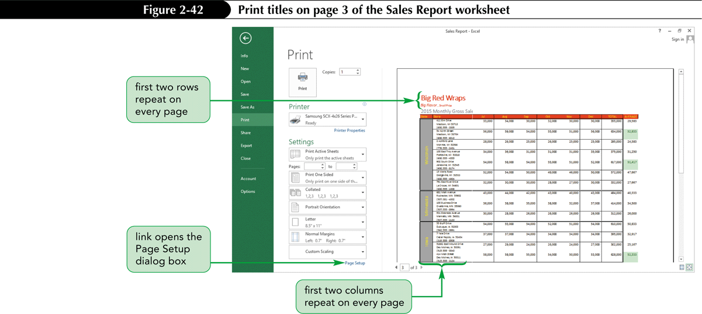
Formatting the Worksheet for Printing
Add print titles (descriptive information) on each page of a printout in case pages become separated

Slide 57
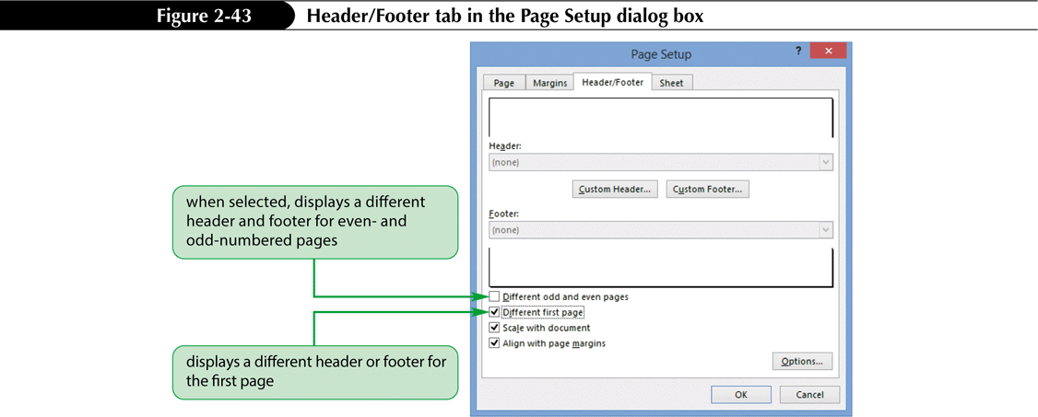
Formatting the Worksheet for Printing
Create page headers and footers to include text not usually found within the worksheet
Headers and footers have three sections: left, center, right

Slide 58
Formatting the Worksheet for Printing
A margin is the space between the page content and the edges of the page
By default, Excel sets the page margins to
  0.7 inch on the left and right sides
  0.75 inch on the top and bottom
  0.3-inch margins around the header and footer
You can reduce or increase these margins as needed by selecting predefined margin sizes or setting your own

